Slide 1
What is Java?
Java is a software platform devised by Sun Microsystems with a specific emphasis on Object-Oriented Programming (OOP) and portability
Most software devs regard Java as an “ecosystem.”
There is a set of Java specifications and principles.
There is a Java programming language.
There are multiple Java IDEs (“Big 3”+ others).
There are multiple Java compilers.
There are multiple Java virtual machines.
One focus of this course is the Java programming language, but OOP and (to a lesser extent) IDEs are points of emphasis.

Slide 2
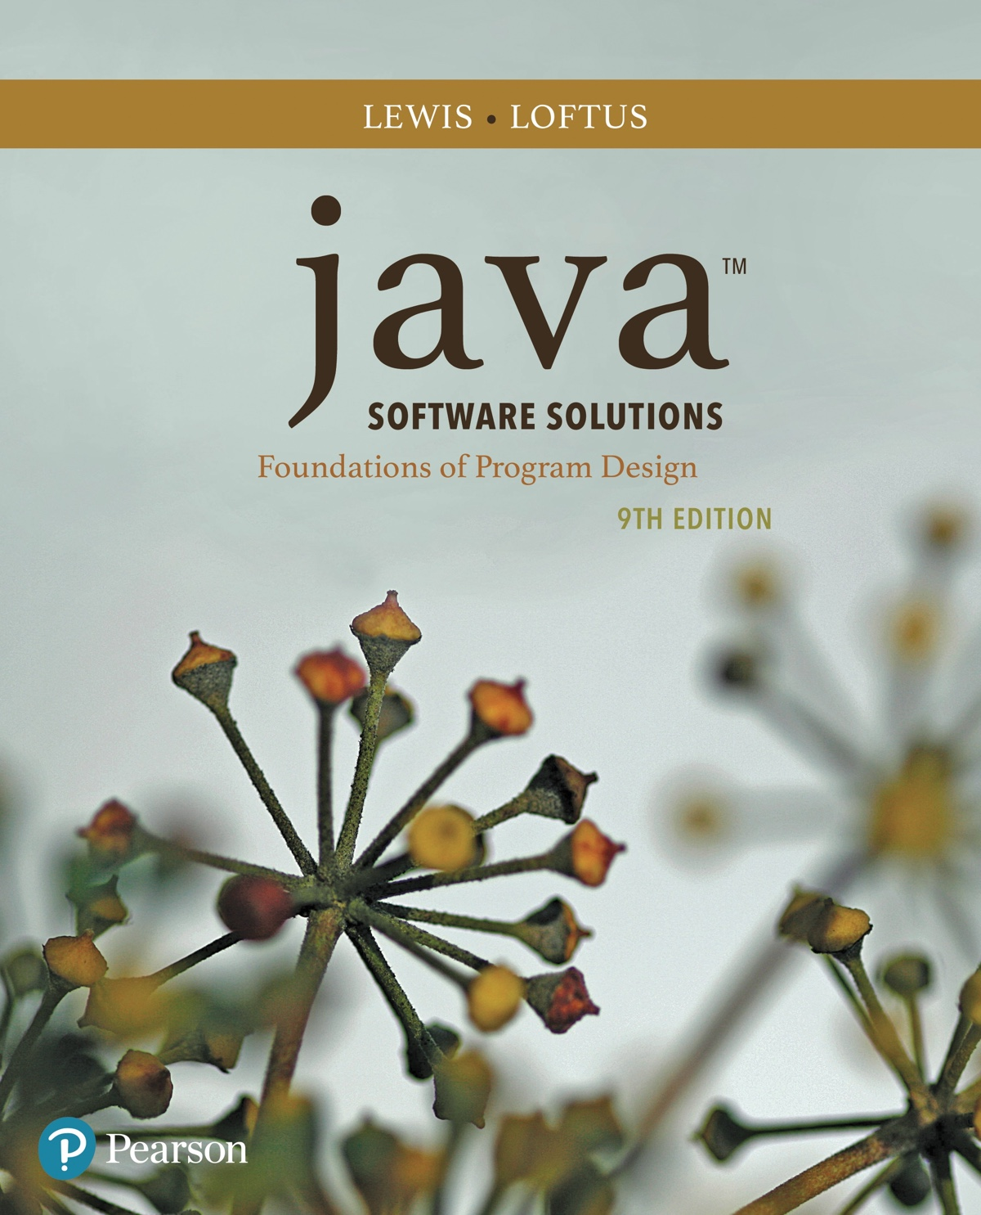
Chapter 1 Introduction
Java Software Solutions
Foundations of Program Design
9th Edition
John Lewis
William Loftus

Slide 3
What is Object Oriented Programming?
Object oriented programming (OOP) is a paradigm based on a hierarchy consisting of archetypes (classes), individual entities (objects), descriptive attributes (fields) and procedures (methods).
The classic alternative to OOP is functional programming.
OOP or a hybrid approach are common in practice.
OOP has four guiding concepts.
Encapsulation isolates code capabilities.
Abstraction isolates user code responsibilities.
Inheritance adds versatility through class reusability.
Polymorphism adds versatility through method reusability.

Slide 4
Integrated Development Environments
An Integrated Development Environment (IDE) is a user-friendly application that assists a programmer in performing the major steps of program development (writing, debugging, optimizing, etc.)
Actual elements of IDEs vary, but almost always include a text (code) editor, debugging capabilities, and compilers/interpreters/VMs as appropriate.
In this course we look at two IDEs (2nd optional):
BlueJ: a teaching IDE that covers Java and OOP basics.
Eclipse: a full-scale Java production environment.

Slide 5
Introduction
We start with the fundamentals of computer processing (setting the stage for OOP and Java)
Chapter 1 focuses on:
components of a computer
how computers store and manipulate information
computer networks
the Internet and the World Wide Web
programming and programming languages
an introduction to Java
an overview of object-oriented concepts

Slide 6
Outline
Computer Processing
Hardware Components
Networks
The Java Programming Language
Program Development
Object-Oriented Programming

Slide 7
Hardware and Software
Hardware
the physical, tangible parts of a computer
keyboard, monitor, disks, wires, chips, etc.
Software
programs and data
a program is a series of instructions
A computer requires both hardware and software for practical operation.
Programs typically rely on input and output to permit software to interface with hardware.

Slide 8
CPU and Main Memory
Central
Processing
Unit
Chip that executes program commands
Primary storage area for programs and data that are in active use
Synonymous with RAM
Main
Memory

Slide 9


Input / Output Devices
Central
Processing
Unit
I/O devices facilitate
user interaction
Main
Memory
Monitor screen
Keyboard
Mouse
Touch screen

Slide 10


Secondary Memory Devices
Information is moved
between main and
secondary memory
as needed
Central
Processing
Unit
Hard Disk
Main
Memory
Secondary memory
devices provide
long-term storage
USB Flash Drive

Slide 11
Devices and Java
Java has several simple (and likely familiar) means of accessing devices through the System class.
System.out is the standard output stream (e.g. for outputting information to a display device)
System.in is the standard input stream (e.g. for reading keyboard input).
System.err is the standard error stream.
The extensive collection of Java libraries permits far more fine-tuned device control and information.
For example, the FileStore class lets us retrieve a great deal of information about a storage device (storage type, total capacity, available space, etc.)

Slide 12
What’s Next?
The remainder of this chapter is devoted to introductory material.
We first address some software and hardware fundamentals.
We then talk a little bit about networks in practice.
Lastly, we introduce the Java programming language in the context of software and coding, and compare/contrast it to other languages.

